Slide 1
Academic Success Data Exploration
Daniel peshkov

Slide 2
Dataset Description
Active Kaggle Competition: Classification with an Academic Success Dataset
The target variable is long-term academic success (dropout, enrolled or graduate)
Data was mostly clean except for 2 rows with missing course information
36 total features, 19 Numeric and 17 Categorical
Pearson Correlation will be used for continuous numeric data
Cramer’s V Association metric will be used for categorical data

Slide 3
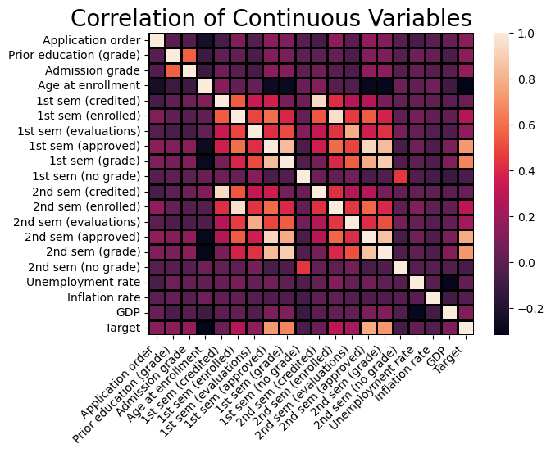
Correlation of Numeric Data
Most features have little to no correlation
Hotspots around number of courses approved, number of courses enrolled, and average grade
Largely irrelevant to target data

Slide 4
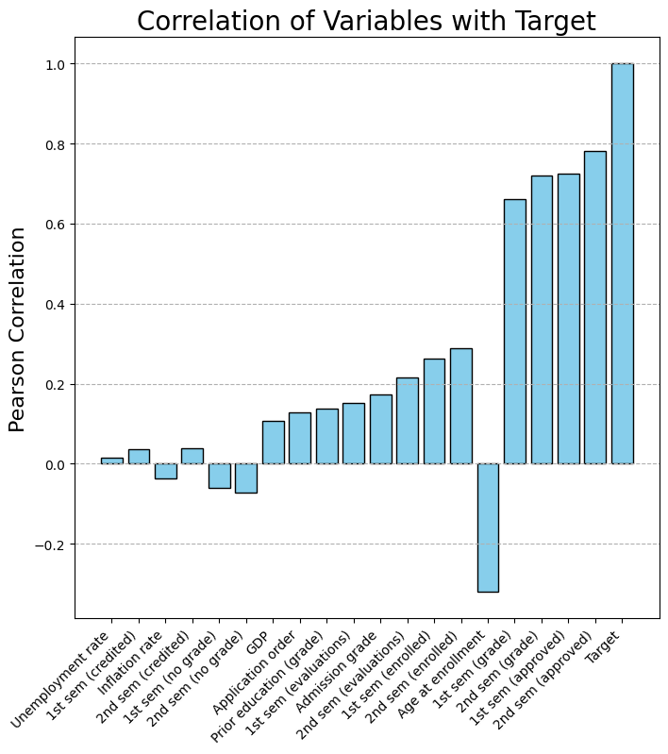
Correlation against Target
High Correlation: Credits Approved and Avg Grade
Negative Correlation: Age
Many variables have little correlation (Prior grades and grade at admission)
Economic factors seem to be mostly irrelevant in this dataset

Slide 5
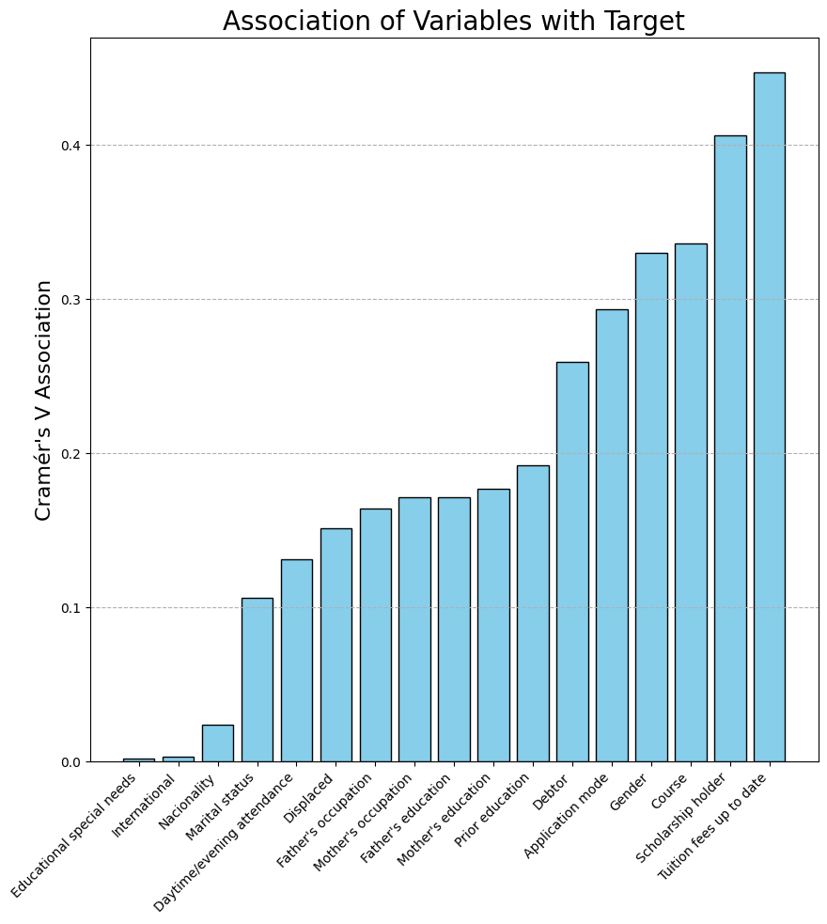
Association of Categorical Data
Unlike correlation, association does not imply direction
Most columns are binary values, yes or no
Nationality, home country and special needs status seem to be mostly irrelevant
Tuition fees being up to date and Scholarship status have the highest association
Most features have very mild association in between
Enrolled course has 3rd highest association and is not binary, it has many possible options

Slide 6
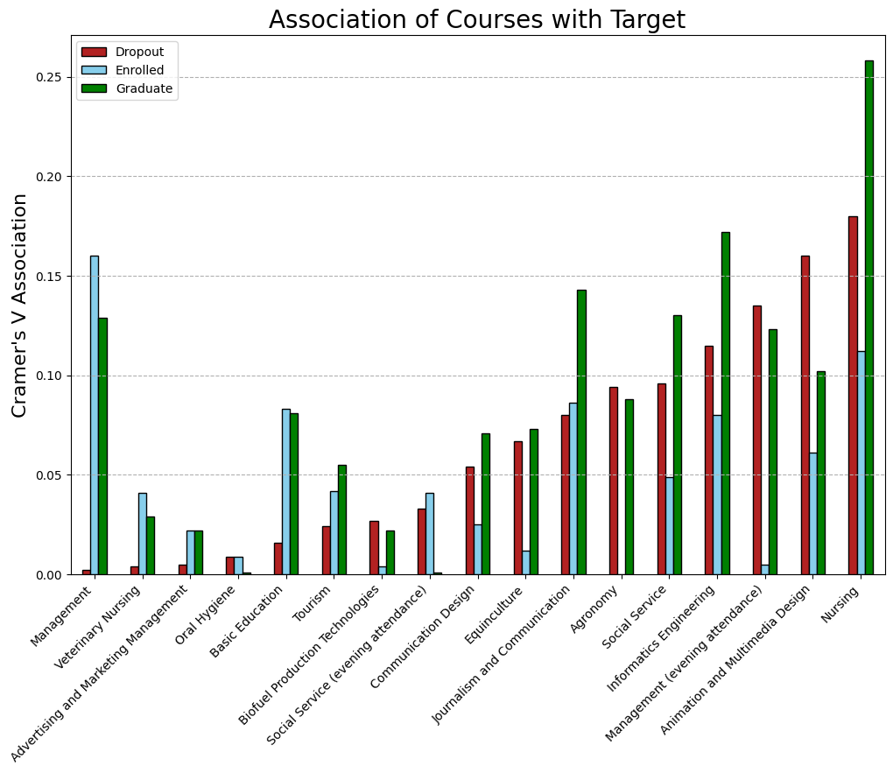
Course Associations Breakdown
Some courses have vastly higher association with academic success than others (Nursing vs Oral Hygiene)
Some courses have high association with graduating but not dropout (Management)
High association with graduating does not mean more likely to graduate. Association does not reflect direction of relationship; it could easily mean the opposite.

Slide 7
Areas of Future Exploration
Why does age have the only negative correlation?
Why do factors like previous education performance have so little correlation with academic success?
Why do some classes have strong associations but not others? Do those classes do anything different?

